Slide 1
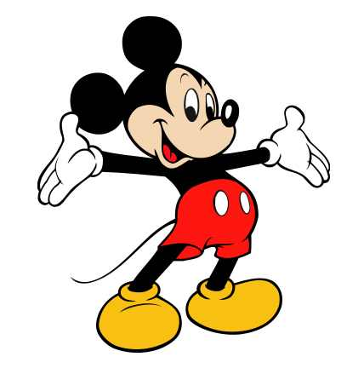

Welcome
students

Slide 2
Good morning
All of you

Slide 3
Gopal Dey
Assistant Teacher
Moracengi govt. primary school, Laxmichari, Khagrachari.

Slide 4

Class One
English

Slide 5

Learning outcomes :
Student will be able to sing the song .
Student will be able to say the alphabet(a, b, c).

Slide 6
Let’s see a video
& sing every one with the video clips

Slide 7
Unit – 2 (Let’s learn abc.)
Lesson – 1 –
Alphabet song

Slide 8
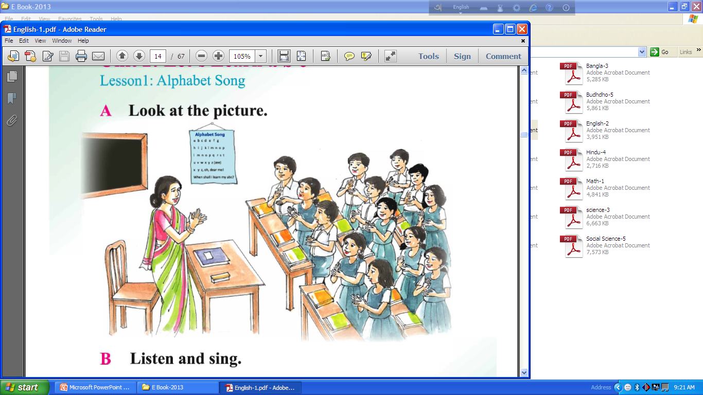
Now look at the picture
What you see hear ?
We also see there is a Alphabet song in the class room
Students
Teacher

Slide 9
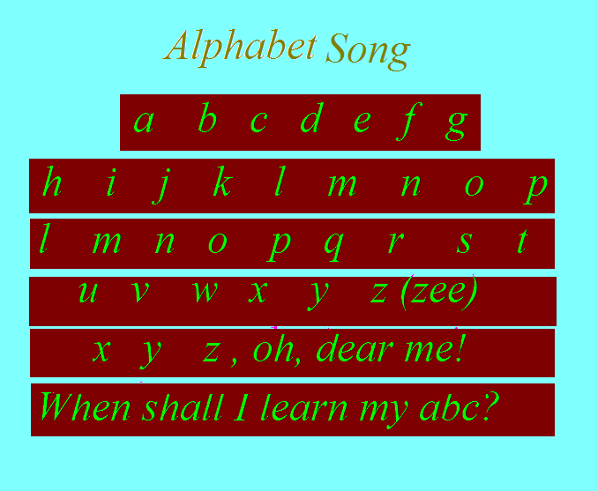
Now see the alphabet song

Slide 10
Now see the video & listen, then sing

Slide 11
Now sing with me
Now sing with him/her

Slide 12
Now sing the song with music(claping)

Slide 13
b
a
c

Slide 14
b
a
c

Slide 15
Now sing the next line of the song
a b c d e f g
h I j k l m n o p
…………………………………………………………………………………
l m n o p q r s t
u v w x y z (zee)
…………………………………………………………………………………

Slide 16

That’s all for today.
Good bye.

